Slide 1






Demand Forecasting for E-Commerce
Infosys Springboard
19th JULY 2024

Slide 2
Our Team –
Sandipan Rakshit duttabikram768@gmail.com
JaswanthSivaji Godasu
godasujaswanthsivaji01@gmail.com
Jeffrey J
jefy2004@gmail.com
Madhalasa S. J
madhalasasj1407@gmail.com
Jatin Gupta
jatingupta261001@gmail.com
Aranya Pal aranya.pal.fiem.cse21@teamfuture.in
Misala Manjunath Reddymanjunathreddymisala7@gmail.com
Presented by -

Slide 3
Problem Statement
Introduction
Exploratory Data Analysis –
Data Preprocessing
Check Missing values and Dropping Duplicates
Analysis of Outliers and replacement
Feature Engineering
Correlation Matrix
Linear Regression –
Effect of Clicks over Quantity
Effect of Facebook Impressions over Quantity
Facebook Impressions vs Clicks
Visualization –Regression –
Day, Week and Month wise Analysis of Quantity, Clicks and FB Impressions
Weekday vs Weekend analysis of Quantity, Clicks and FB Impressions
Trends aggregated plot
Time Series Analysis–
Stationary Test
ADF Statistics
ACF and PACF plot
Demand Forecasting Models –
I. AR II. MA III. ARMA
IV. ARIMA V. SARIMA
VI. ARIMAX VII. SARIMAX
VIII. Multivariate Regression
Comparison of all Forecasting Models
CONTENT

Slide 4
The realm of E-Commerce, demand forecasting plays a pivotal role in ensuring business success. This project aims to develop a demand forecasting model in an E-commerce business that predicts future product demand leveraging time series analysis and multivariate regression based on historical sales data, along with Google Analytics KPIs such as Google clicks and Facebook impressions, which are valuable indicators of customer interest.
Develop a model to predict future product demand.
Using historical sales data, Google Clicks, and Facebook Impressions.
Use time series models (such as AR, MA, ARIMA, etc.) and multivariate regression for sales prediction.
PROBLEM STATEMENT

Slide 5


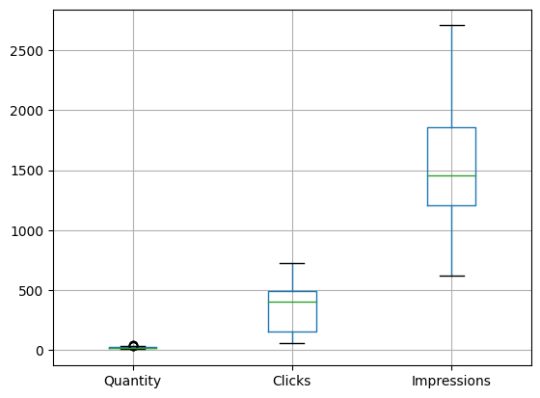
INTRODUCTION
EXPLORATORY DATA ANALYSIS
Three Excel sheets are given to us –
ProductA_google_clicks.xlsx (contains Day Index and corresponding Google Clicks data)
ProductA_fb_impressions.xlsx (contains Day Index and corresponding Facebook Impressions data)
ProductA.xlsx (contains Day Index and corresponding Quantity Sales data)
Merging Data Set through EDA
We have merged all three data sets through Exploratory Data Analysis into a Data set “Merged_product.xlsx” by using Left Join and we got 212 rows and 4 columns (‘Day Index’, ‘Quantity’, ‘Clicks’ and ‘Impressions’ ).
DATA PREPROCESSING AND FEATURE ENGINEERING
Missing values and Duplicate entries were not found in the data.
5 Outliers were Detected in the Quantity variable and they were replaced with 97th percentile.
Multiple features were engineered to improve models performance such as Weekday_Monday, Weekday_Tuesday, etc. and Month_January, Month_February, etc.
In the competitive and fast-paced world of E-Commerce, predicting product demand with accuracy is essential for businesses to thrive. Proper demand forecasting ensures optimal inventory management, reduces operational costs, and enhances customer satisfaction.
This project focuses on developing a sophisticated demand forecasting model that utilizes historical sales data alongside key performance indicators (KPIs) from Google Analytics, such as Google clicks and Facebook impressions.
By leveraging advanced time series analysis and multivariate regression techniques, the model aims to uncover insights into market trends, seasonal patterns, and the effectiveness of online advertising. Identifying the correlation between past and future sales, clicks, and impressions will help in building precise autoregressive models and understanding the lagged effects of marketing efforts. Ultimately, this project aspires to provide E-Commerce businesses with actionable insights and accurate demand forecasts, enabling them to make informed decisions, optimize their operations, and improve their market strategies.

Slide 6
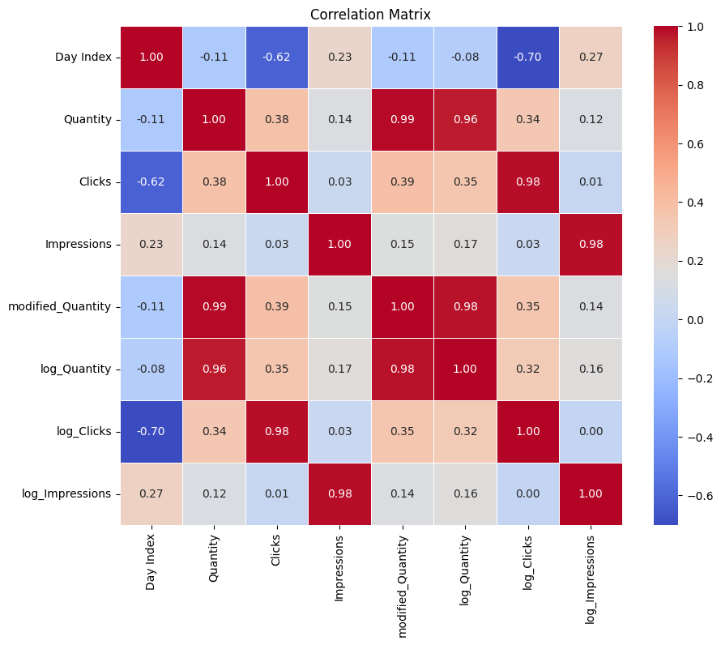
Correlation matrix
From the correlation matrix, we derive following conclusions:
Clicks have good positive correlation with Quantity
Impressions also have slight positive relation to Quantity
Impressions also have a very minute positive relation to Clicks (more Impressions leading to more Clicks)

Slide 7

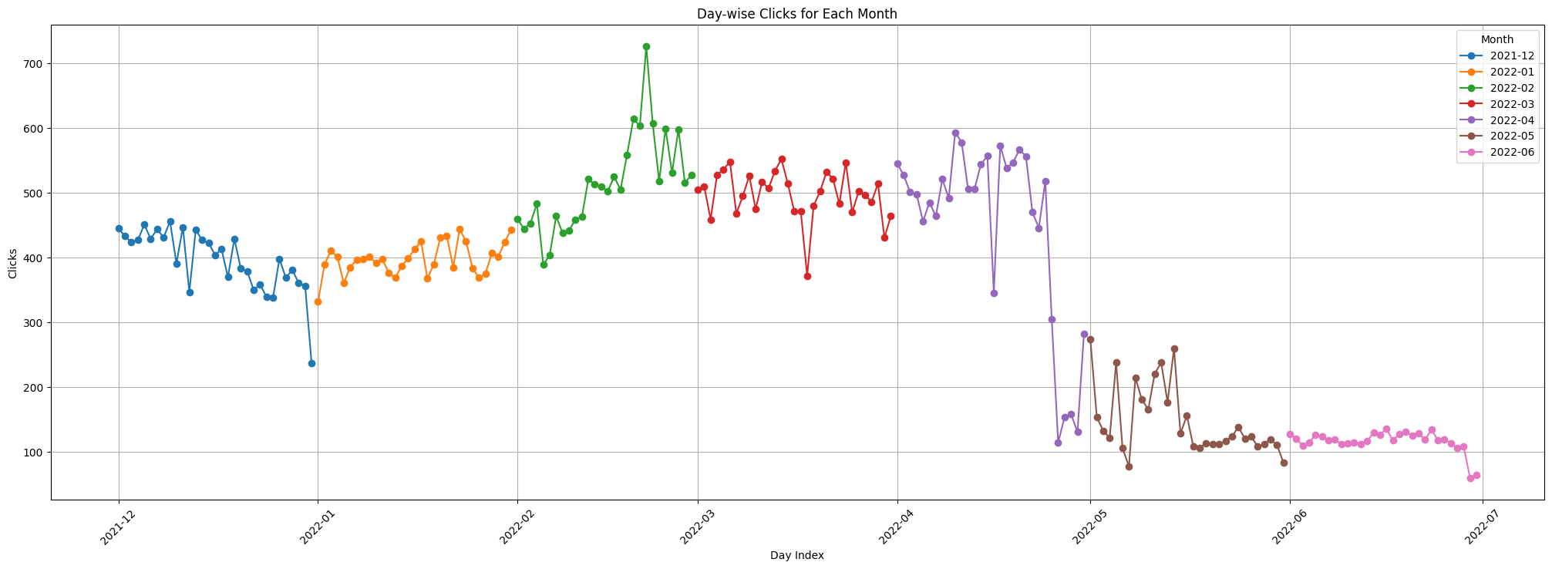
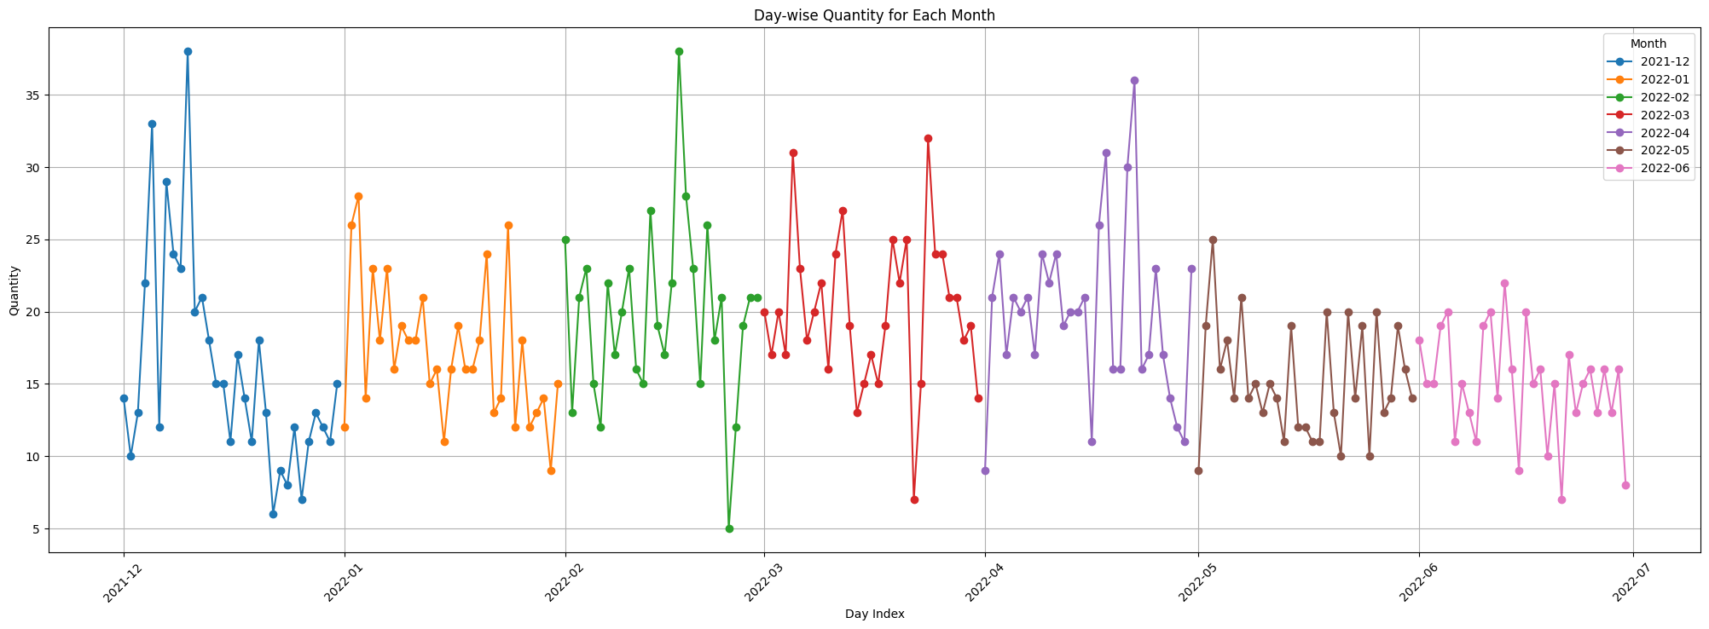
VISUALIZATION
Day wise Quantity for each month
There are more peaks in the month of December, March, April and May.

Slide 8
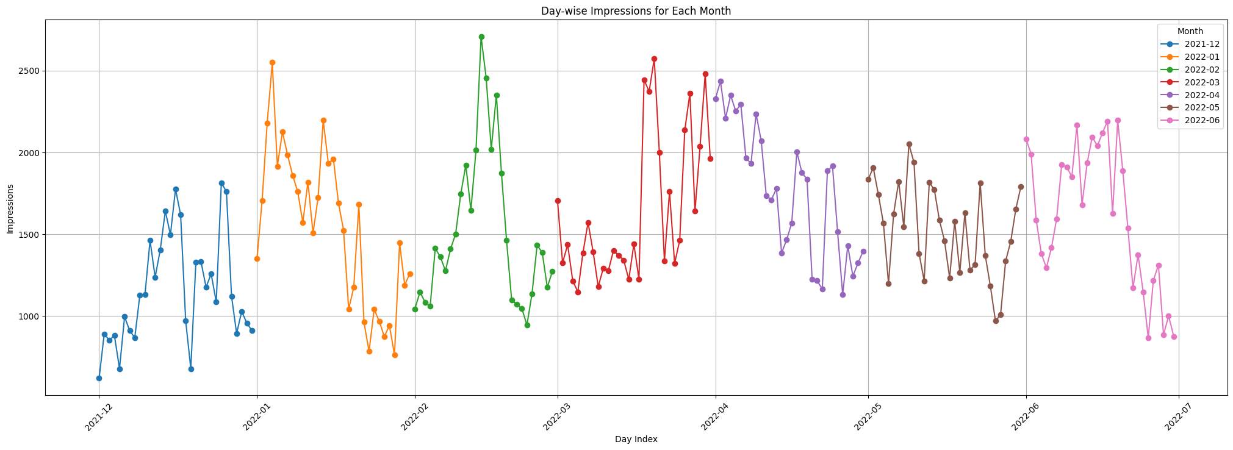
Day wise Clicks for each month
Least clicks
Month of May and June have the lowest Clicks, while February has highest peak.

Slide 9
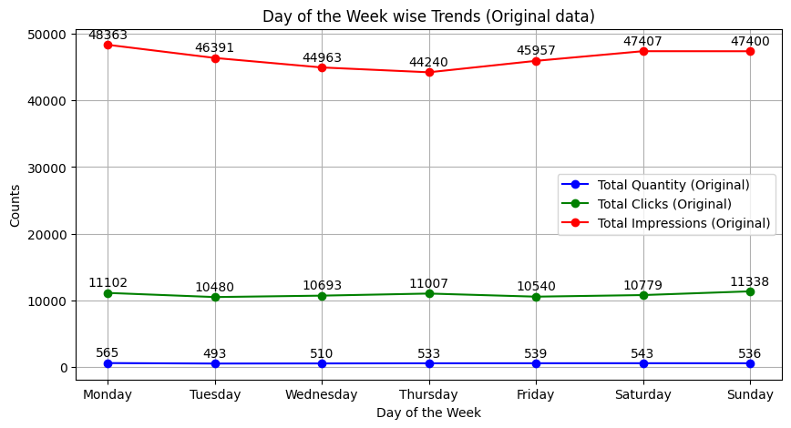
Day wise Impressions for each month
Highest peak of impressions is in the month of March, followed by February and April.

Slide 10
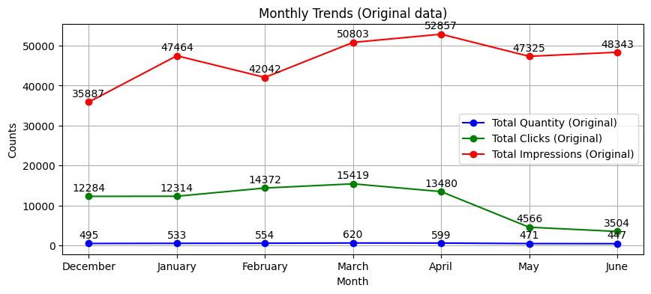
Trend
Monday accounts for the most Impressions.
Clicks peaks on Sunday and Monday.
Quantity peaks on Monday, followed by Saturday.

Slide 11
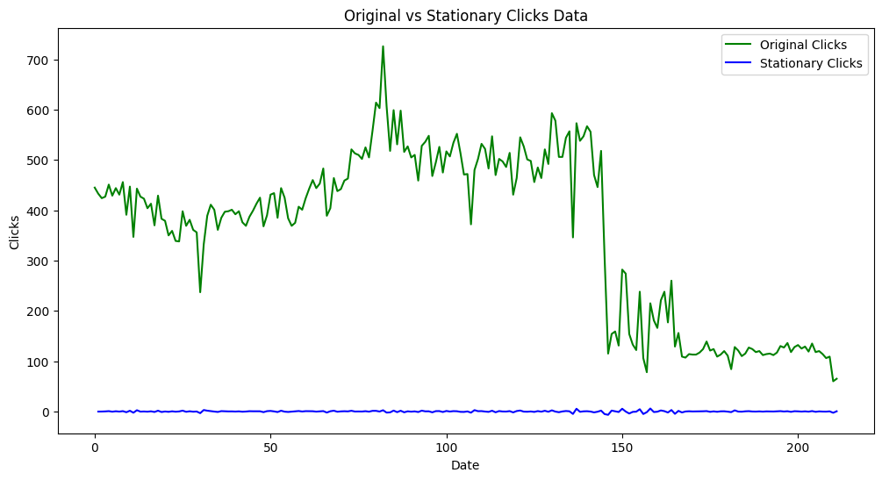
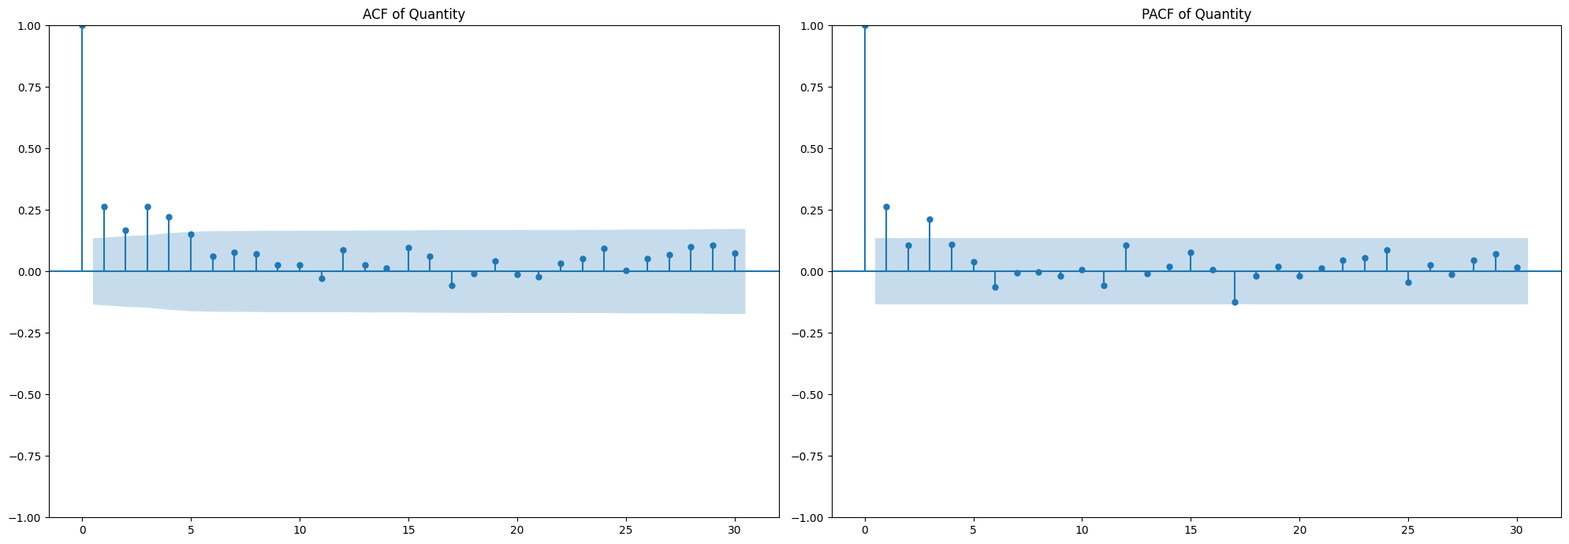
Impressions peak in the month of April.
Clicks peaks in the month of March.
Quantity also peaks in the month of March.

Slide 12
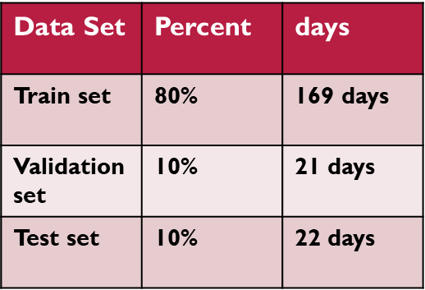
Time Series Hypothesis test
Stationarity test
By Stationarity test we get to know that ‘Quantity’ is stationary ‘Clicks’ is non stationary and ‘Impressions’ is stationary. So we converted ‘clicks’ to stationary.
ADF Statistics
From ADF Statistics we get to know that no. of lags in ‘Quantity’ is 1.
Data series is found to be stationary for Quantity and Impressions attribute using ADF test.
Hence, order of differencing is zero, i.e. d=0.
ACF and PACF plot of Quantity
In both the ACF and PACF plots, there is a single biggest spike in the beginning.
Hence, the value of p and q are 1 and 1, respectively.
Hence, optimal parameter order is p, d, q = (1, 0, 1)

Slide 13

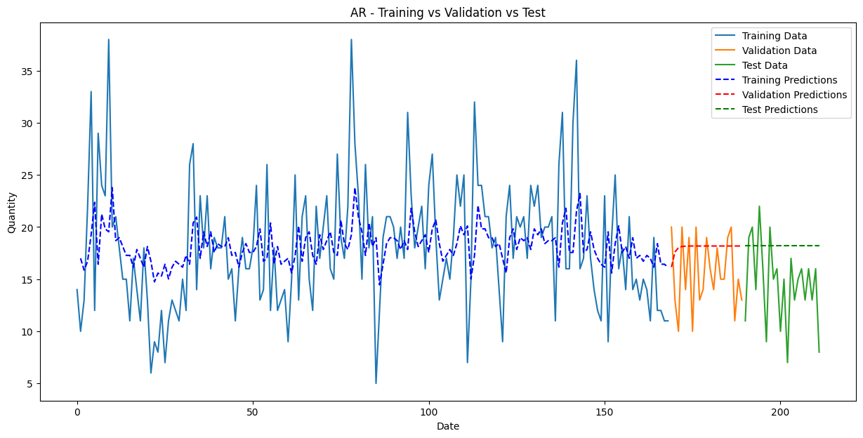
Data Splitting :
We have considered a splitting ration –
Training data : Validation data : Test data = 80 : 10 : 10
TIME SERIES MODELS
Used to train the model
Used to test the model

Slide 14

Autoregressive Model (AR) :
Moving Average Model (MA) :
Test Set Metrics for AR:
MSE: 27.603
MAE: 4.344
MAPE: 39.291%
R2: -0.878
Adjusted R2: 4.586
Test Set Metrics for MA:
MSE: 27.386
MAE: 4.325
MAPE: 39.120%
R2: -0.863
Adjusted R2: 4.558
R² is negative due to the small size of data.

Slide 15


Autoregressive Moving Average Model (ARMA) :
Autoregressive Integrated Moving Average Model (ARIMA) :
Test Set Metrics for ARMA:
MSE: 26.473
MAE: 4.243
MAPE: 38.387%
R2: -0.801
Adjusted R2: 4.439
Test Set Metrics for ARIMA:
MSE: 26.473
MAE: 4.243
MAPE: 38.387%
R2: -0.801
Adjusted R2: 4.439
Both the models show same results, as the order of differencing was zero, i.e. d = 0.

Slide 16
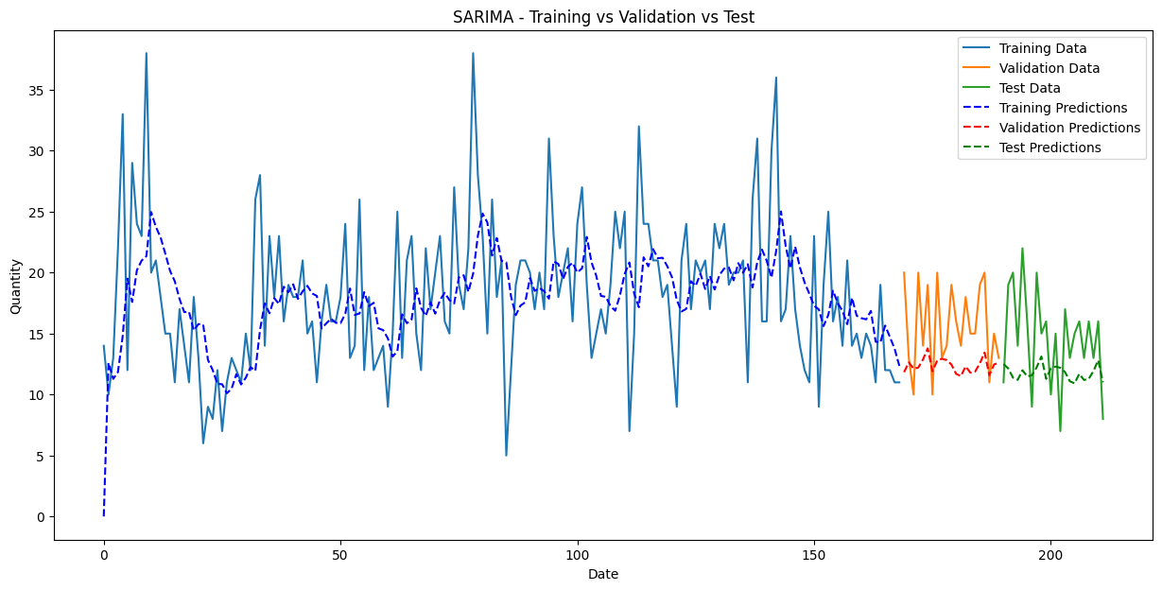
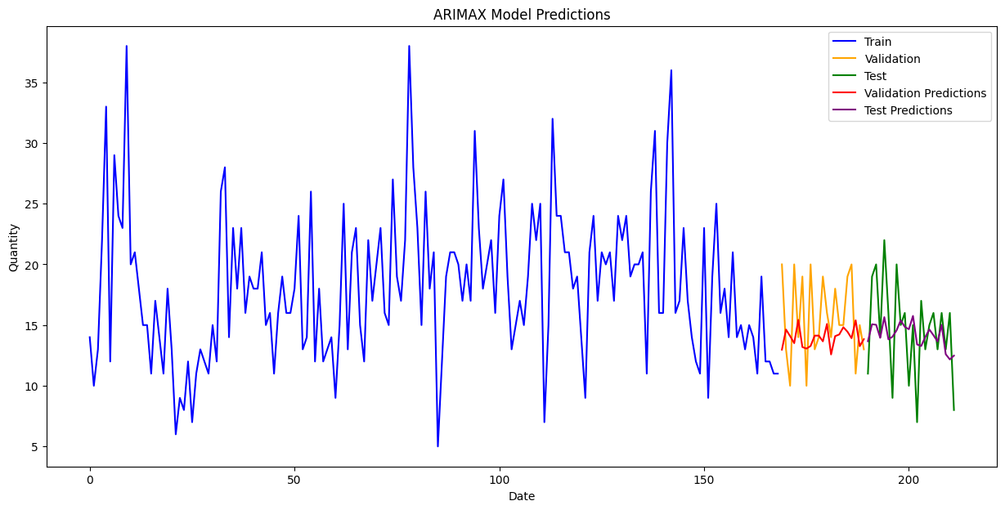
Seasonal Autoregressive Integrated Moving Average Model (SARIMA) :
Autoregressive Integrated Moving Average with Exogenous Variables Model (ARIMAX) :
Test Set Metrics for SARIMA:
MSE: 22.489
MAE: 4.114
MAPE: 28.084%
R2: -0.53
Adjusted R2: 3.921
ARIMAX Test Set Metrics:
MSE: 12.121
MAE: 2.784
MAPE: 22.111%
R2: 0.175
Adjusted R2: -1.887

Slide 17

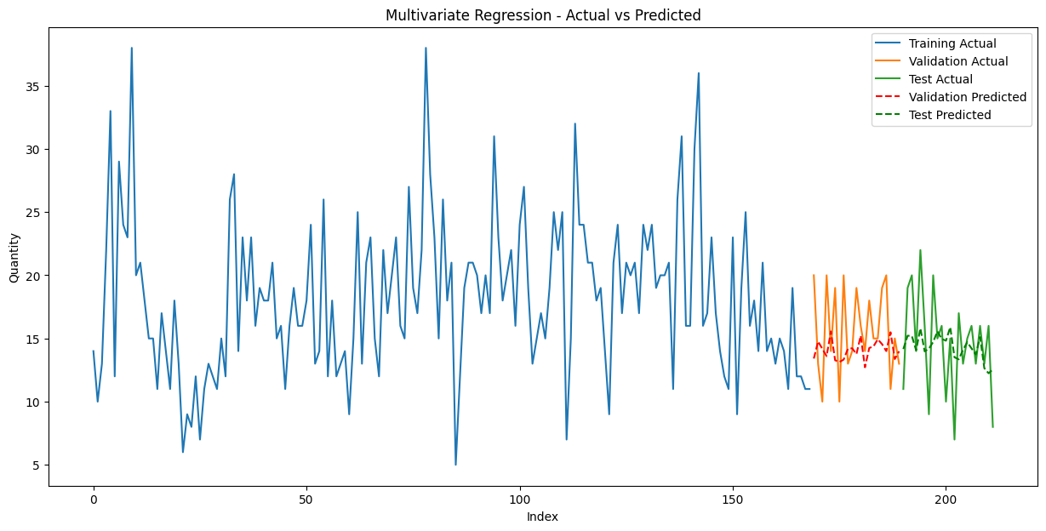
Seasonal Autoregressive Integrated Moving
Average with Exogenous Variables Model (SARIMAX) :
Multivariate Regression Model (MR) :
SARIMAX Test Set Metrics:
MSE: 12.081
MAE: 2.785
MAPE: 22.147%
R2: 0.178
Adjusted R2: -1.877
Test Set Metrics for Multivariate Regression:
MSE: 12.114
MAE: 2.792
MAPE: 22.393%
R2: 0.176
Adjusted R2: -1.885

Slide 18

Conclusion
The best model is found to be the SARIMAX model with a 12 month seasonality and a group of important features used such as Clicks, Impressions, Weekday_Monday, Weekday_Tuesday, and Month_January, Month_February, etc., followed by the multivariate regression.
Final Model SARIMA – Actual vs Forecast plot
The SARIMAX model leverages a 12-month seasonal pattern to capture annual trends, enhancing prediction accuracy. It also performs well in forecasting previously unseen data.
Metric | Validation Set (SARIMAX) | Test Set (SARIMAX)
MSE | 15.15 | 12.02
MAE | 3.16 | 2.78
MAPE | 19.67% | 22.21%
R² | -0.37 | 0.18
Adjusted R² | -4.5 | -1.9

Slide 19
Impact of the Model
Enhanced Forecast Accuracy: Utilizes 12-month seasonality, capturing yearly trends and improving prediction precision.
Robust Forecasting: Provides reliable forecasts even with previously unseen data, thanks to its ability to generalize from the trained patterns.
Scalability: Can be scaled to handle larger datasets and more complex feature sets without loss of performance.
Multivariate Analysis: Supports the inclusion of multiple exogenous variables (e.g., Clicks, Impressions) to refine predictions and insights.

Slide 20

VALIDATION SET METRICS COMPARISON
Error Metrics / Models | AR | MA | ARMA / ARIMA | SARIMA | ARIMAX | SARIMAX | Multivariate Regression
MSE | 18.023 | 17.871 | 14.750 | 20.139 | 15.776 | 15.150 | 15.300
MAE | 3.573 | 3.556 | 3.374 | 3.637 | 3.231 | 3.166 | 3.192
MAPE | 26.54% | 26.26% | 24.465% | 23.13% | 20.08% | 19.67% | 19.937%
R² | -0.639 | -0.625 | -0.341 | -0.831 | -0.434 | -0.378 | -0.391
Adjusted R² | 3.521 | 3.500 | 3.063 | 3.817 | -4.738 | -4.51 | -4.565
Annexure
TEST SET METRICS COMPARISON
Error Metrics / Models | AR | MA | ARMA / ARIMA | SARIMA | ARIMAX | SARIMAX | Multivariate Regression
MSE | 28.025 | 27.512 | 26.682 | 22.111 | 12.124 | 12.025 | 12.132
MAE | 4.381 | 4.336 | 4.263 | 4.078 | 2.784 | 2.784 | 2.790
MAPE | 35.41% | 35.03% | 34.414% | 27.79% | 22.08% | 22.21% | 22.310%
R² | -0.907 | -0.872 | -0.816 | -0.505 | 0.175 | 0.182 | 0.175
Adjusted R² | 4.337 | 4.276 | 4.177 | 3.633 | -1.887 | -1.864 | -1.889
R² is negative due to the small size of data.

Slide 21
Thank you!
We would like to express our heartfelt gratitude to all the viewers for attending our presentation.
Any Queries?

